Slide 1
Economic crisis and bankruptcy of enterprises
Lau Yam Chun

Slide 2
Question & objectives
How economic or financial crisis cause enterprises bankrupt? (the effect to small, medium, and large firm)
Are all the Economic or financial crisis have similar features or the reason of bankruptcy are the same?
Can we use time series data to predict the number of bankruptcy in the future? (E.g. 2019 Pandemic)
Can we protect the firms or avoid bankruptcy based on the analysis?

Slide 3
Economic crisis across the world
1995-2001 dot-com
2001-2002 Argentine Economic Crisis
2007-2009 Global Financial Crisis
2014 Russian Financial Crisis
2009 European Debt Crisis
…..

Slide 4
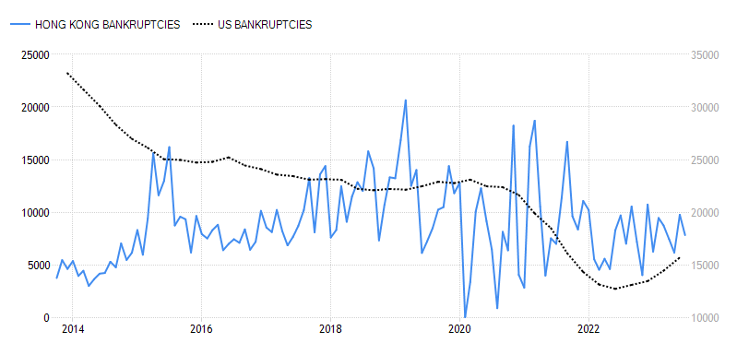
Business bankruptcies Hong Kong vs U.S

Slide 5
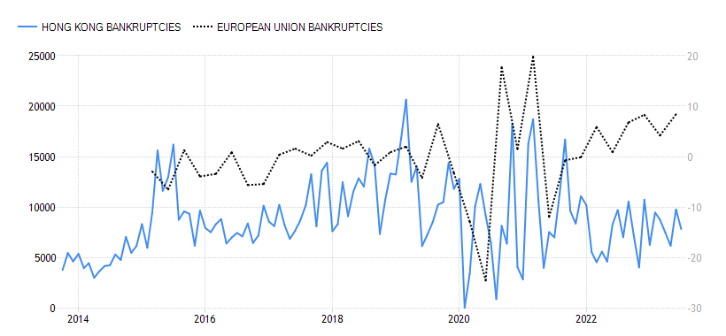
Business bankruptcies Hong Kong vs European

Slide 6
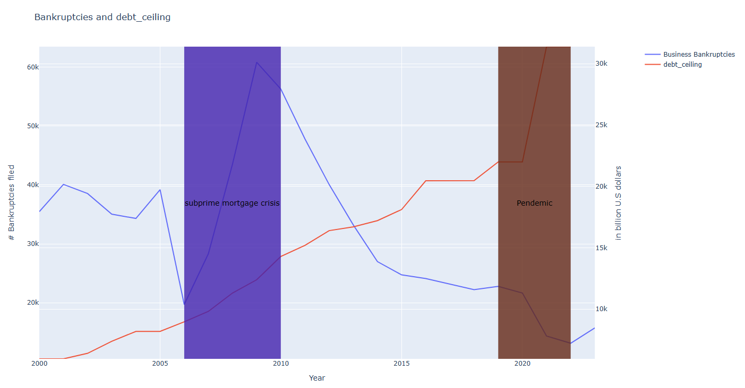
Shallow data analysis

Slide 7
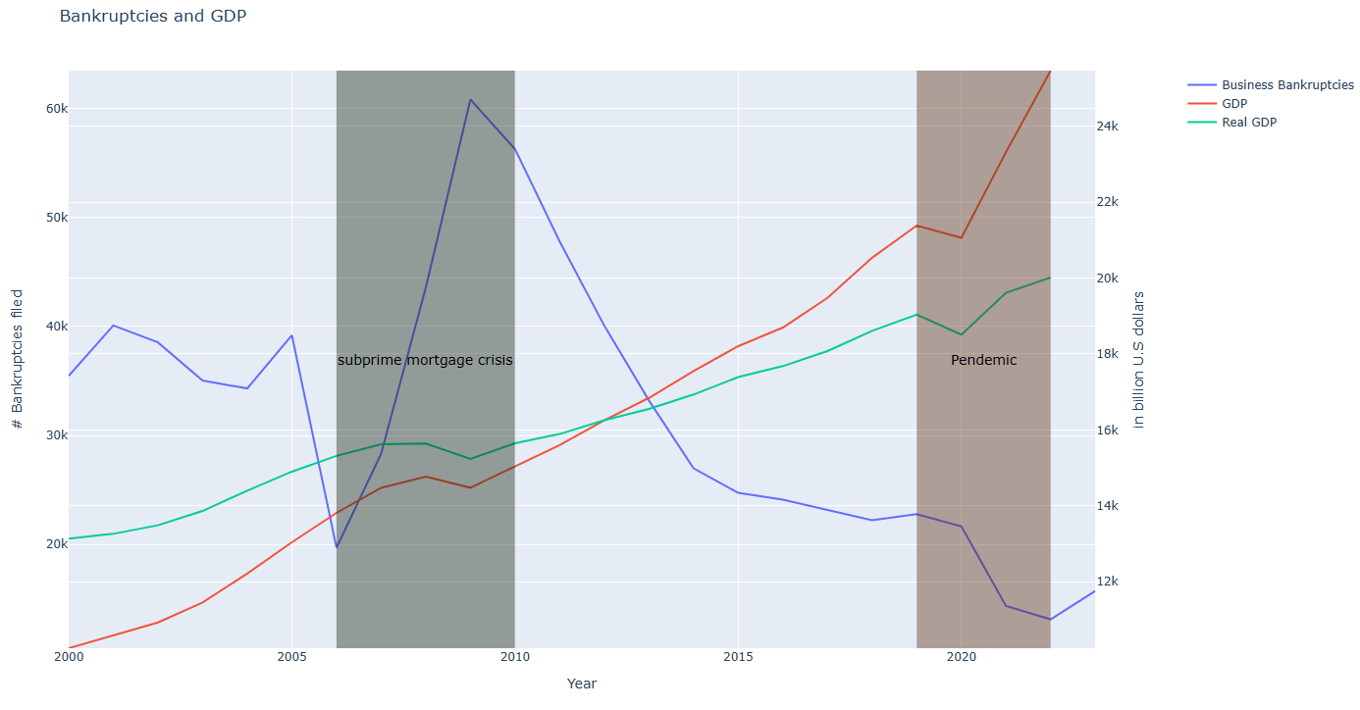
- 2006 – 2009, number of bankruptcies has spectacular surge, while both gdp and real gdp only decrease a bit.

Slide 8
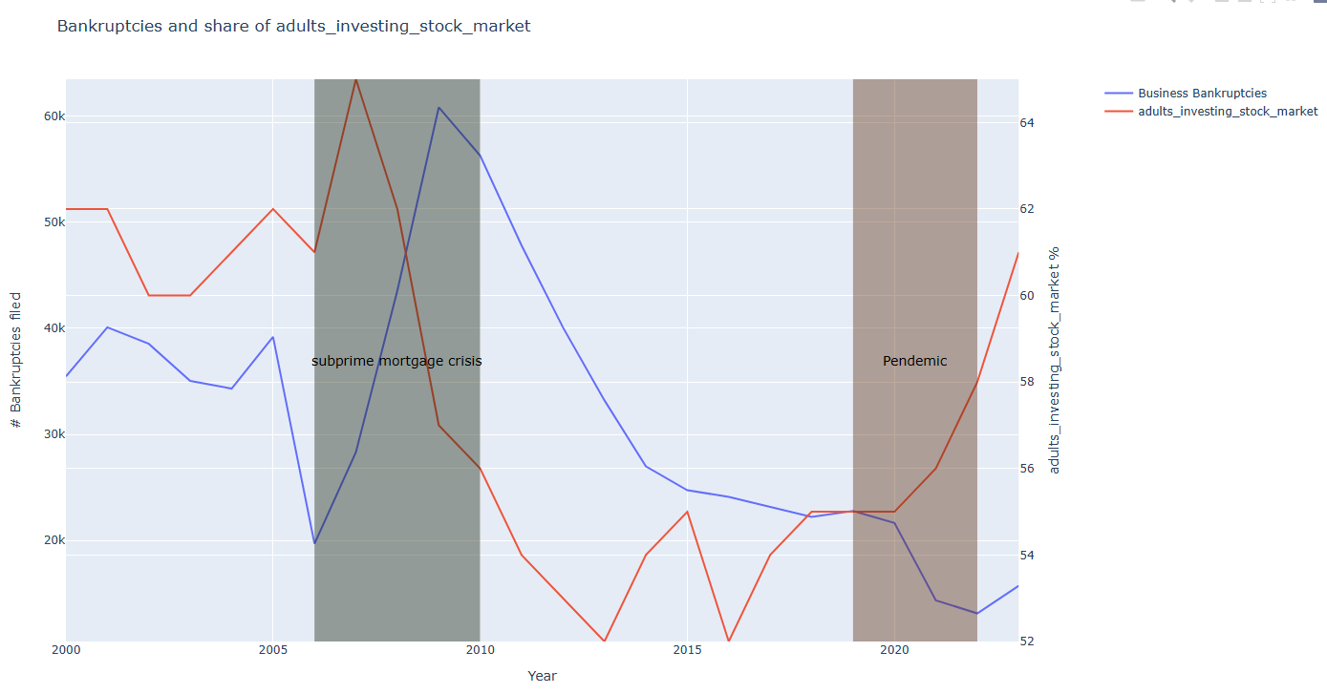

Slide 9
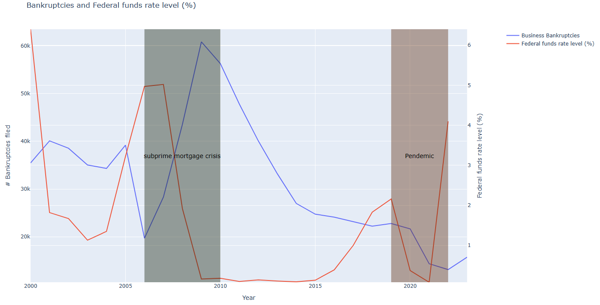

Slide 10
Methodology
Time Series Analysis:
Multivariate time series -> Vector Autoregression model
Cross time and countries bankruptcy data, macro economic data (oil price, gdp), inflation, housing index, rent index, unemployment rate, average salary cross sectors ….

Slide 11
Reference
https://www.eurofound.europa.eu/en/resources/article/2010/effects-economic-crisis-italian-economy
https://ec.europa.eu/economy_finance/publications/pages/publication15951_en.pdf

